Slide 1

WRITING SQL INNER JOINS
Bukola Olafenwa
Academic Mentor at The LETTA Trust, London​​

Slide 2

Presentation outline
What makes a JOIN.
Types of JOIN.
INNER JOIN.
Syntax for writing an INNER JOIN.
Writing an INNER JOIN.
Summary.

Slide 3
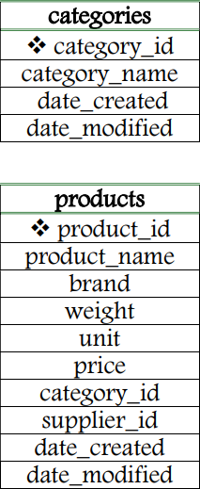
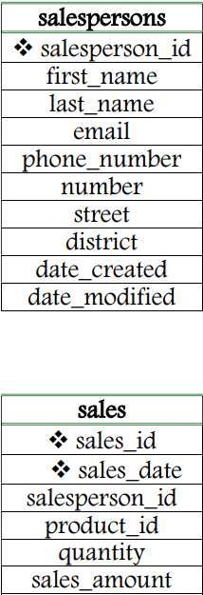
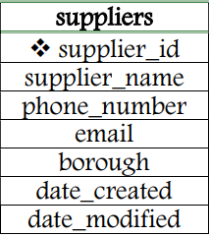
What MAKES A JOIN?
A data ANALYTICAL OPERATION
A SQL JOIN is a data analytical operation performed to retrieve data from fields of two or more tables in a single query.

Slide 4
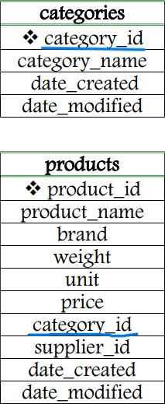
What MAKES A JOIN?
ROLE OF A related field(s)
As two or more tables are involved, data combination is necessarily based on a common field(s) that connects the tables.

Slide 5
What MAKES A JOIN?
ALIASING
Field names are often necessarily qualified by table names to achieve clarity and a successful return of a desired result set.
WHAT’S MORE?
There are different types of the SQL JOIN.
INNER JOIN
LEFT (OUTER) JOIN
RIGHT (OUTER) JOIN
FULL (OUTER) JOIN

Slide 6
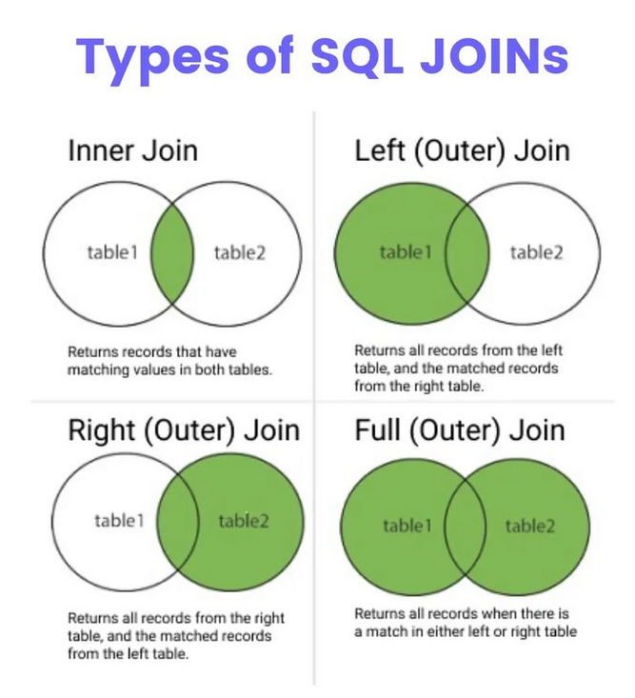

Slide 7

FOCUS
INNER JOINS!

Slide 8
SYNTAX FOR WRITING AN INNER JOIN
SELECT column list,
FROM table1
(INNER) JOIN table2
ON table1.column = table2.column;

Slide 9
SYNTAX FOR WRITING AN INNER JOIN
SELECT column list,
FROM table1
(INNER) JOIN table2
USING (column);

Slide 10
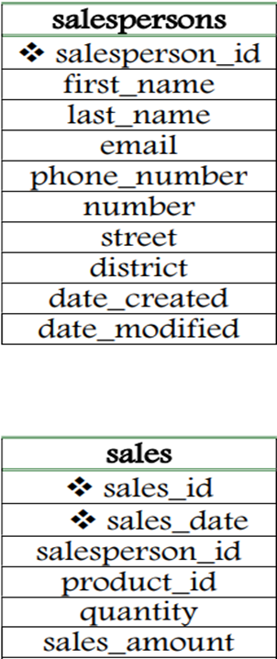
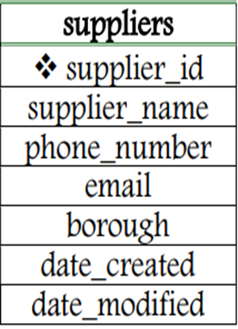
SAMPLE RELATIONAL DATABASE
FIVE TABLES

Slide 11
WHAT NEXT?
LET’S WRITE SOME INNER JOINS!

Slide 12
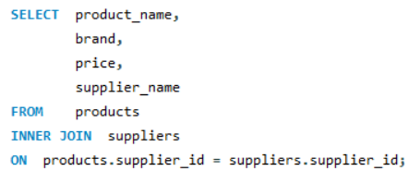
WRITING AN INNER JOIN (OF TWO TABLES)
SAMPLE QUESTION
Retrieve the name, brand, price and supplier name for all products.
WITHOUT BEING ALIASED

Slide 13
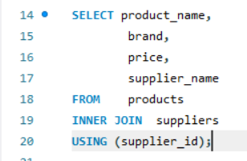
WRITING AN INNER JOIN (OF TWO TABLES)
SAMPLE QUESTION
Retrieve the name, brand, price and supplier name for all products.
WITHOUT BEING ALIASED (WITH ‘USING’ COMMAND)

Slide 14
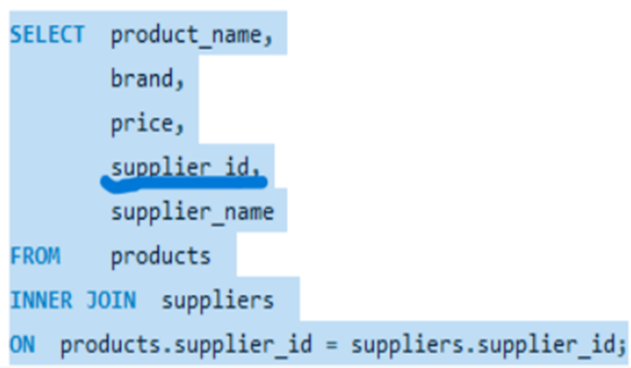
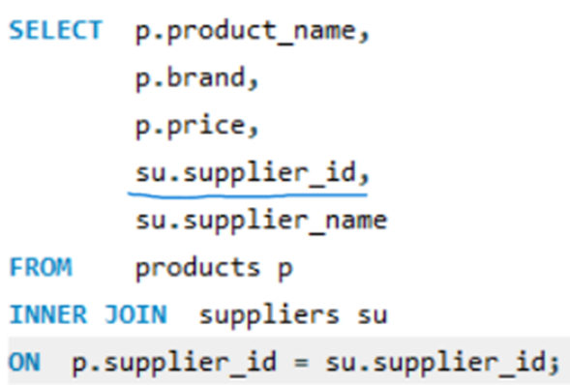

WRITING AN INNER JOIN (OF TWO TABLES)
SAMPLE QUESTION
Retrieve the name, brand, price, supplier_id and supplier name for all products.
WITHOUT ALIASING
CORRECTLY ALIASED

Slide 15
MORE QUESTIONS ON WRITING AN INNER JOIN
WITH TWO TABLES:
Write queries to find the following:
All products supplied by suppliers from Deptford.
Total sales amount for each product id and name.
Total sales amount per salesperson, including salesperson name.
Salesperson with the highest total sales amount.
WITH THREE TABLES:
Retrieve the category name, product name, and supplier name for all products.

Slide 16
Summary
Aliasing in joins makes coding successful by affording clear naming of columns and shortening table names.
The ‘ON’ command can work for a common field with different names but the ‘USING’ command can only work for a common field having the same name in the tables involved.
Inner joins are a popular group of joins that play crucial roles in the success of day-to-day complex data analytical operations.

Slide 17
References
Bukola, O. bukola-2023/BUKOLA-PROJECTS: Bukola's Project Profile (github.com)
https://twitter.com/Python_Dv/status/1721309165967323608
https://www.tutorialrepublic.com/sql-tutorial/sql-cross-join-operation.php
https://databasefaqs.com/sql-server-self-join/
Udemy. Course: The Ultimate MySQL Bootcamp: Go from SQL Beginner to Expert | Udemy
CFG (2023). Code First Girls (2023). Data ANALYSIS FOR complex structures.

